Slide 1



Data-driven web-based intelligent decision support systems for infection management at the point of care
"Revolutionizing Antimicrobial Decision-Making: Harnessing the Potential of AI and Machine Learning in Integrated Clinical Decision Support Systems” - ChatGPT
Bernard Hernandez
b.hernandez-perez@imperial.ac.uk
Department of Medicine
Imperial College London
https://bahp.github.io/portfolio-academic/
21th of June 2023
1
Notes:
"Revolutionizing Antimicrobial Decision-Making: Harnessing the Potential of AI and Machine Learning in Integrated Clinical Decision Support Systems”
“Amplifying Healthcare: Unleashing the Power of AI and Machine Learning in Clinical Decision Support Systems” "Elevating Antimicrobial Decision-Making: Empowering Hospitals with AI and Machine Learning in Clinical Decision Support Systems"

Slide 2






BACKGROUND
Rey Juan Carlos University (URJC), Madrid, Spain
B.Sc. in Telecommunications
B.Sc. in Computer Science
Royal Institute of Technology (KTH), Stockholm, Sweden
M.Sc. in Machine Learning
Imperial College London (ICL), London, United Kingdom
Ph.D. in Computer Science and Healthcare

Slide 3












AREAS OF RESEARCH FOR CDSS
Areas of research to leverage healthcare through clinical decision support systems
Management to facilitate access to records, laboratory results, and communication.
Facilitate data collection to enhance decisions, send reminders or clinical alerts
Patient engagement to improve understanding and shape future patient behaviour
Assess or predict complications using machine learning methods on tabular patient data
Review of past similar cases to improve decisions matching clinicians’ reasoning process
AMR surveillance to strengthen knowledge for action in support of strategies to improve guidelines
Support medication from allergy checking, and therapy selection to adjusting antimicrobial doses
Using NLP to extract medical information from free-text clinical notes
Image processing to extract useful information from medical imaging (X-ray, CT, MRI)
+ more!
Notes:
Management
Easy access to records
Facilitate visualisation and communication
Reminders, alerts…
Patient engagement
AI & Decision Making
Case-Based Reasoning
Supervised Machine Learning
Diagnostics & decision making
From vital signs
From imaging
From clinical notes
From lab samples (Dx)
Support medication
Drug selection
Allergy checking
Basic guidance on dosing
Therapeutic Drug Monitoring
Drug interactions

Slide 4
SUPERVISED LEARNING
6, 5, 4
3
2
1
Infection
>500.000 daily profiles
2.7% prevalence
6 biomarkers
CRP, WBC, BIL, CRE, ALT, ALP
SVM
AUC ROC 0.85 (95% CI:0.84 - 0.86)
SENS 0.75 | SPEC 0.91
104 patients
35% prevalence at 72h
42% had microbiological tests
AUC ROC 0.84 (95% CI:0.76 - 0.91)
SENS 0.89 | SPEC 0.63 at 0.81
SARS-CoV-2
1186 patients
65% prevalence
14% had microbiological tests
21 biomarkers
Full Blood Count (FBC)
SVM
AUC ROC 0.91 (95% CI:0.76 - 0.91)
SENS 0.80 | SPEC 0.89
54 patients
52% prevalence
AUC ROC (0.96% CI: 0.90 – 1.00)
SENS 0.75 | SPEC 0.90
Dengue
8100 patients
27.7% prevalence
Age, Gender, Day + 4 biomarkers
HCT, PLT, WBC, LYMPH
XGB
AUC ROC 0.86 (95% CI:0.84 - 0.86)
SENS 0.92 | SPEC 0.56
PPV 0.73 | NPV 0.84
+ seasonality!
Dengue Shock Syndrome
4131 patients
5.4% prevalence
Age, Gender, Weight, Day + 2 biomarkers first 48h
HCT, PLT
ANN
AUC ROC 0.83 (95% CI:0.76 - 0.85)
SENS 0.66 | SPEC 0.84
PPV 0.18 | NPV 0.98
Bloodstream Infection
using temporal dynamics trough LSTM
1. Damien et al – The diagnosis of dengue in patients presenting with acute febrile illness using supervised machine learning and impact of seasonality – Frontiers in Digital Health (2022)
2. Damien et al – Applied machine learning for the risk-stratification and clinical decision support of hospitalised patients with dengue in Vietnam – PLOS Digital Health (2022)
3. TM Rawson et al – Supervised machine learning to support the diagnosis of bacterial infection in the context of COVID-19 – JAC Antimicrobial Resistance – BMC Medicine (2021)
4. B Hernandez et al – Data-driven web based intelligent CDSS for infection management at the point of care – PhD Thesis Imperial College London (2019)
5. TM Rawson et al – Supervised machine learning for the prediction of infection on admission to hospital: a prospective observational cohort study – JAC (2018)
6. B Hernandez et al – Supervised learning for infection risk inference using pathology data – BMC Medical Informatics and Decision Making (2017)
Notes:
Over the years, numerous works and studies have been conducted to explore the application of supervised machine learning in assessing and diagnosing positive microbiology culture as a proxy for various infections, for specific scenarios such as the presence of COVID-19, dengue, dengue shock syndrome, and blood stream infections. Initially, researchers focused on utilizing tabular static data to train machine learning models for classification and prediction tasks. However, as the understanding of these diseases and the mechanisms to collect richer data evolve, researchers realized the importance of longitudinal data in capturing the dynamic nature of infections. Consequently, they began incorporating time-dependent variables and patient histories into their models, enabling more accurate and comprehensive assessments. This shift towards longitudinal data has opened up new avenues for research, fostering advancements in early detection, treatment planning, and overall patient care in the field of infectious diseases.

Slide 5


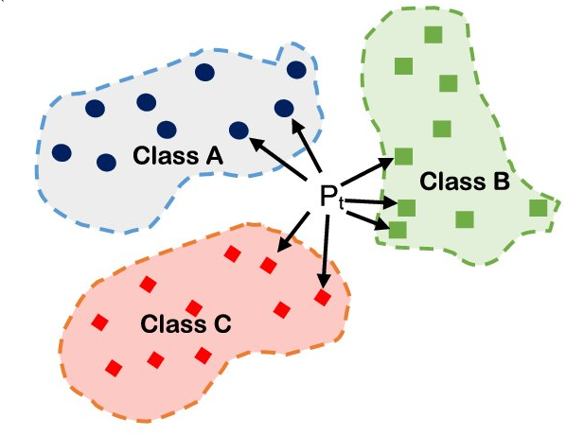
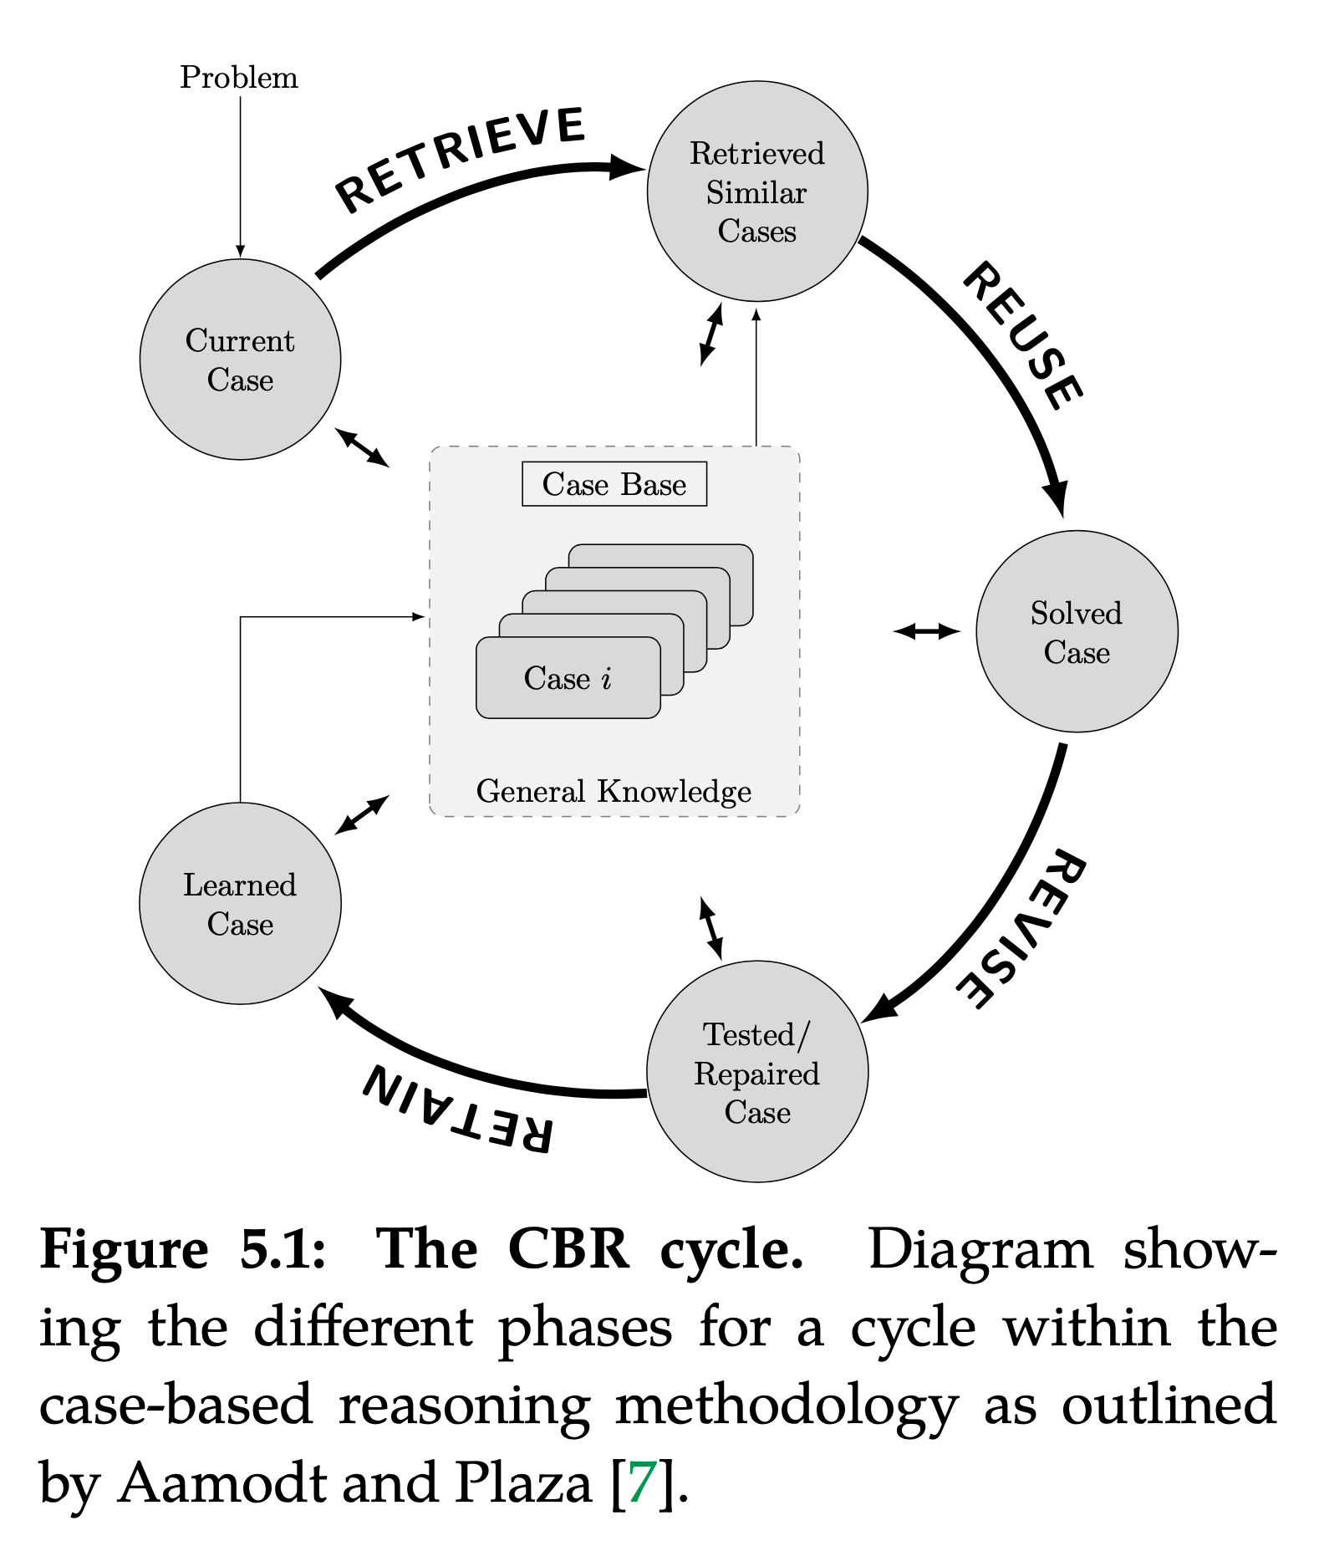
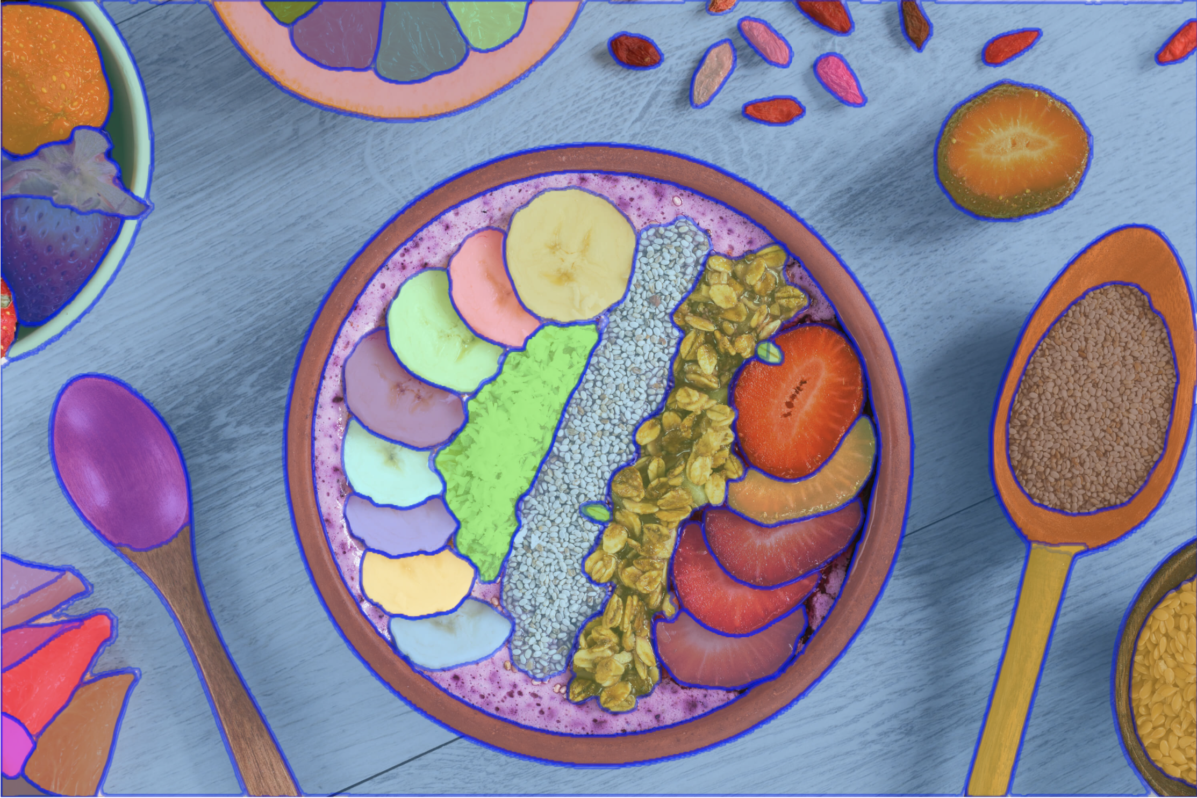
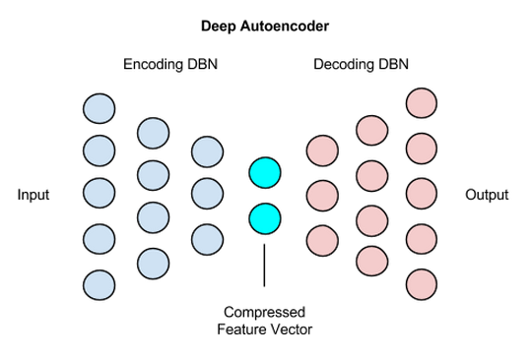
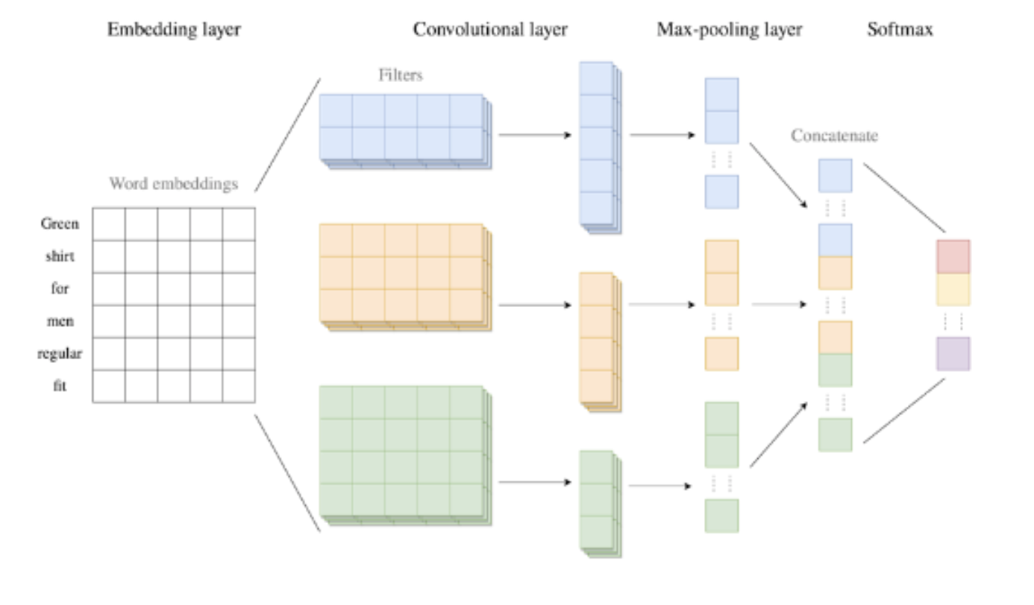
CASE-BASED REASONING
In clinical environments, physician reasoning is based on knowledge acquired from past cases personally experienced which is exactly what CBR does! The aim of CBR is to solve new problems based on the solutions of similar past problems in the form of cases
K-Nearest Neighbours (KNN)
1. TM Rawson et al – A real-world evaluation of a CBR to support antimicrobial prescribing decisions in acute care - CID (2020)
2. B Hernandez et al – Data-driven web-based intelligent CDSS: CBR benefits and limitations – Health informatics (2017)
Notes:
In clinical environments, physician reasoning is based on knowledge acquired from past cases personally experienced which is exactly what CBR does!
​
The aim of CBR is to solve new problems based on the solutions of similar past problems in form of cases. CBR is considered a methodology to follow rather than an algorithm in itself. Initially, the CBR methodology requires a set of cases or training examples denoted as case-base. Then, for a specific query, the CBR cycle is divided into four different phases.
​
Retrieve: Given a query patient, this phase retrieves from the database those cases that are relevant, based on any predefined similarity metric.
Reuse: propose a suitable solution for the query patient by adapting and/or combining the solution of the retrieved cases.
Revise: experts monitor the evolution of the patient to assess whether or not the adapted/proposed solution was appropriate.
Retain: determine whether or not the patient is of utility to be added into the case-base for future queries.
Heterogeneity often appears in healthcare data because patients' populations, environment, procedures, and treatment protocols in medical centres vary. In addition, this data is usually of high complexity and its revision in standard format (e.g forms) is very time consuming. Thus intelligent and intuitive visualisation approaches and performance optimisation for patient similarity retrieval are key! In this section we introduce the similarity retrieval module which allows to identify clinically meaningful projections of such high dimensional data in two dimensions (often called latent space) that (i) align with the established clinical characteristics of a particular disease and its progression and (ii) maps patients with similar manifestations/phenotypes close together in the latent space.
Description graph bottom right
----------------------------------------
The next layer is the convolutional layer. The convolutional layer takes the texts transformed to sequences of word embeddings as input, and creates feature vectors by analysing the word embeddings for each text. This is done by the use of convolution filters. A convolution filter is a matrix that is filled with weights, that analyses multiple consecutive words in a text simultaneously, and continues like this by going through the whole text to create a feature map. This operation is performed for every text, by using multiple convolution filters, to detect various different relationships between the words. The various convolution filters may also differ from each other in height, which indicates how many consecutive words a filter considers simultaneously in each step. To obtain the feature vectors, the feature maps following from the convolution operation all get added a bias term, and an activation function is applied to add non-linearity (ReLU is the most commonly used activation function). This non-linearity enables to learn more complex relationships.
The pooling layer takes the variable-length feature vectors of the convolutional layer as input, and creates fixed-length vectors out of them. By creating these fixed-length feature vectors, the less-relevant local information is removed.
The final layer of the CNN is the softmax layer. This layer takes the fixed-length feature vectors as input, where these vectors first enter a fully-connected layer. This fully-connected layer is an efficient way of learning non-linear combinations of the features. The output of this fully-connected layer are numerical values for each class. To assign a straightforward interpretation to these numbers, the softmax function is applied. The softmax function forces the output of the CNN to represent predicted probabilities for each of the classes. The class achieving the highest predicted probability is the resulting predicted class following from the CNN.
See: https://machine-learning-company.nl/en/technical/convolutional-neural-network-text-classification-with-risk-assessment-eng/

Slide 6
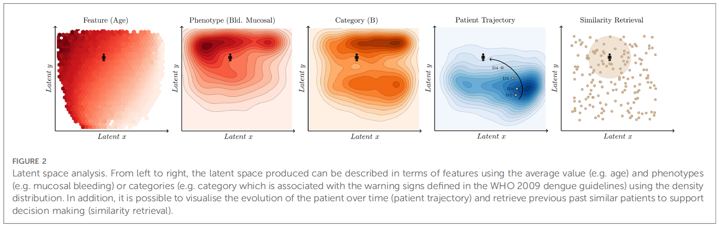
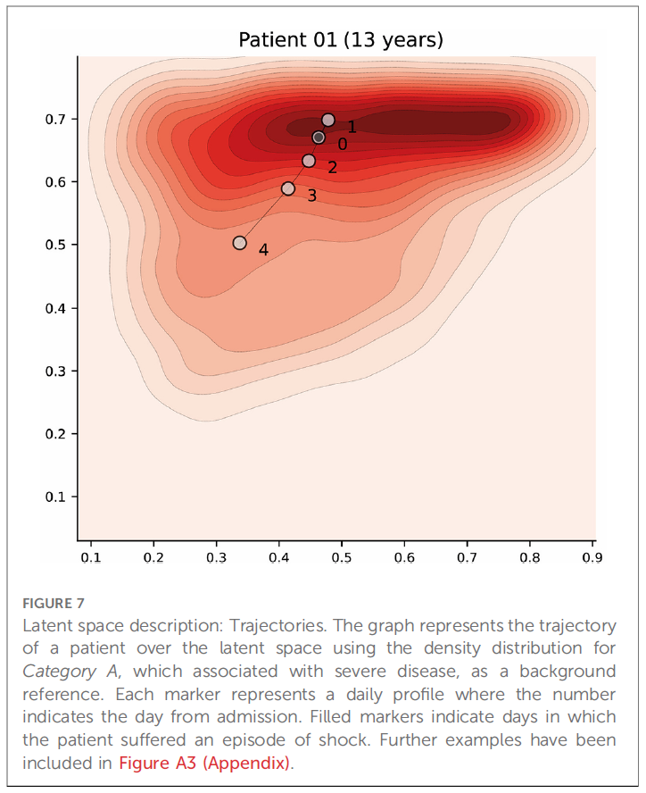
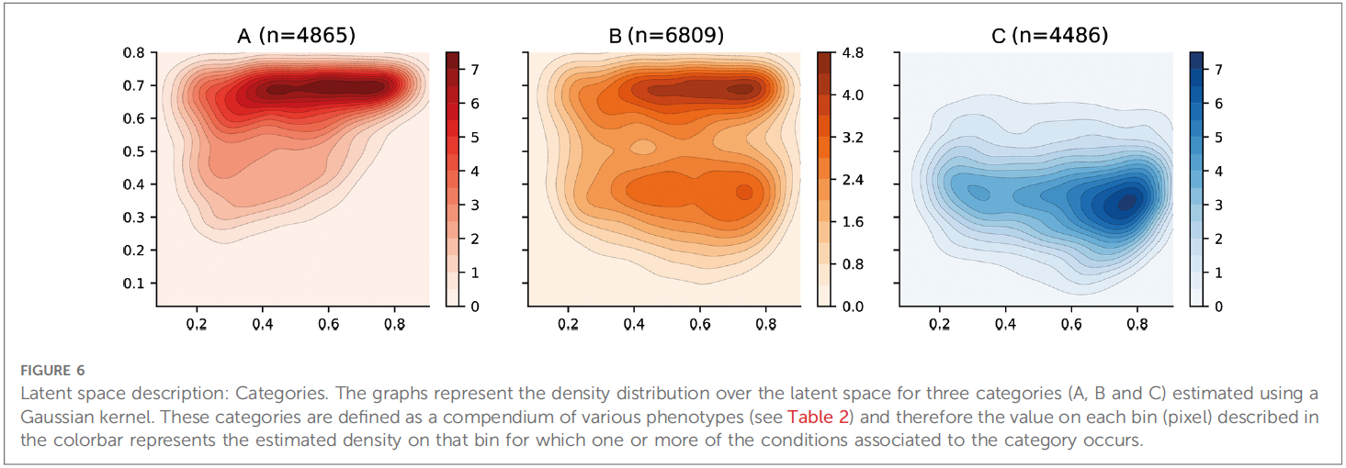
CASE-BASED REASONING - DENGUE
B Hernandez et al – Learning meaningful latent space representations for patient risk stratification: Dengue and other acute febrile illness – Frontier Digital Health (2023)
Notes:
A novel case-based approach, leveraging the power of autoencoders to reduce the input features of dengue patients into a two-dimensional (2D) space for enhanced visualization has been prototype. Dengue, with its well-known disease dynamics encompassing the febrile, critical, and recovery phases, serves as an ideal candidate for this approach. By employing autoencoders, which are neural networks designed to compress and reconstruct data, the vast array of patient features can be effectively condensed into a concise 2D representation. This reduction not only facilitates the efficient retrieval of similar patients but also enables the visualization of patient clusters using density maps, highlighting various phenotypes and categories based on the extracted features. Moreover, this approach allows for the visualization of a patient's evolution over time, providing valuable insights into the progression of the disease. By combining the power of autoencoders and the dynamics of a disease, this case-based approach offers a promising avenue for improved patient characterization and understanding of the disease's intricate patterns.

Slide 7

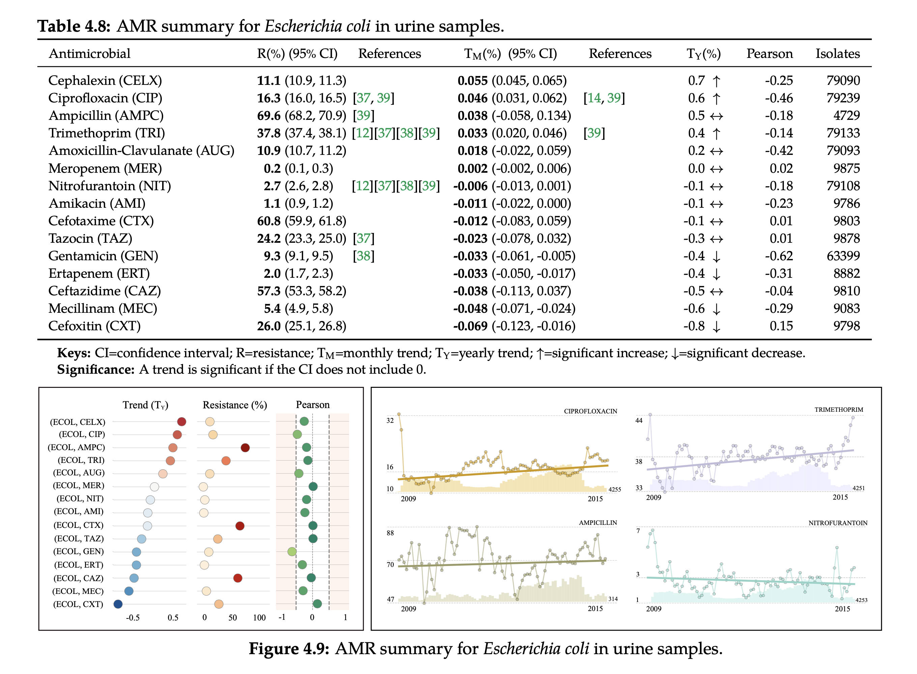
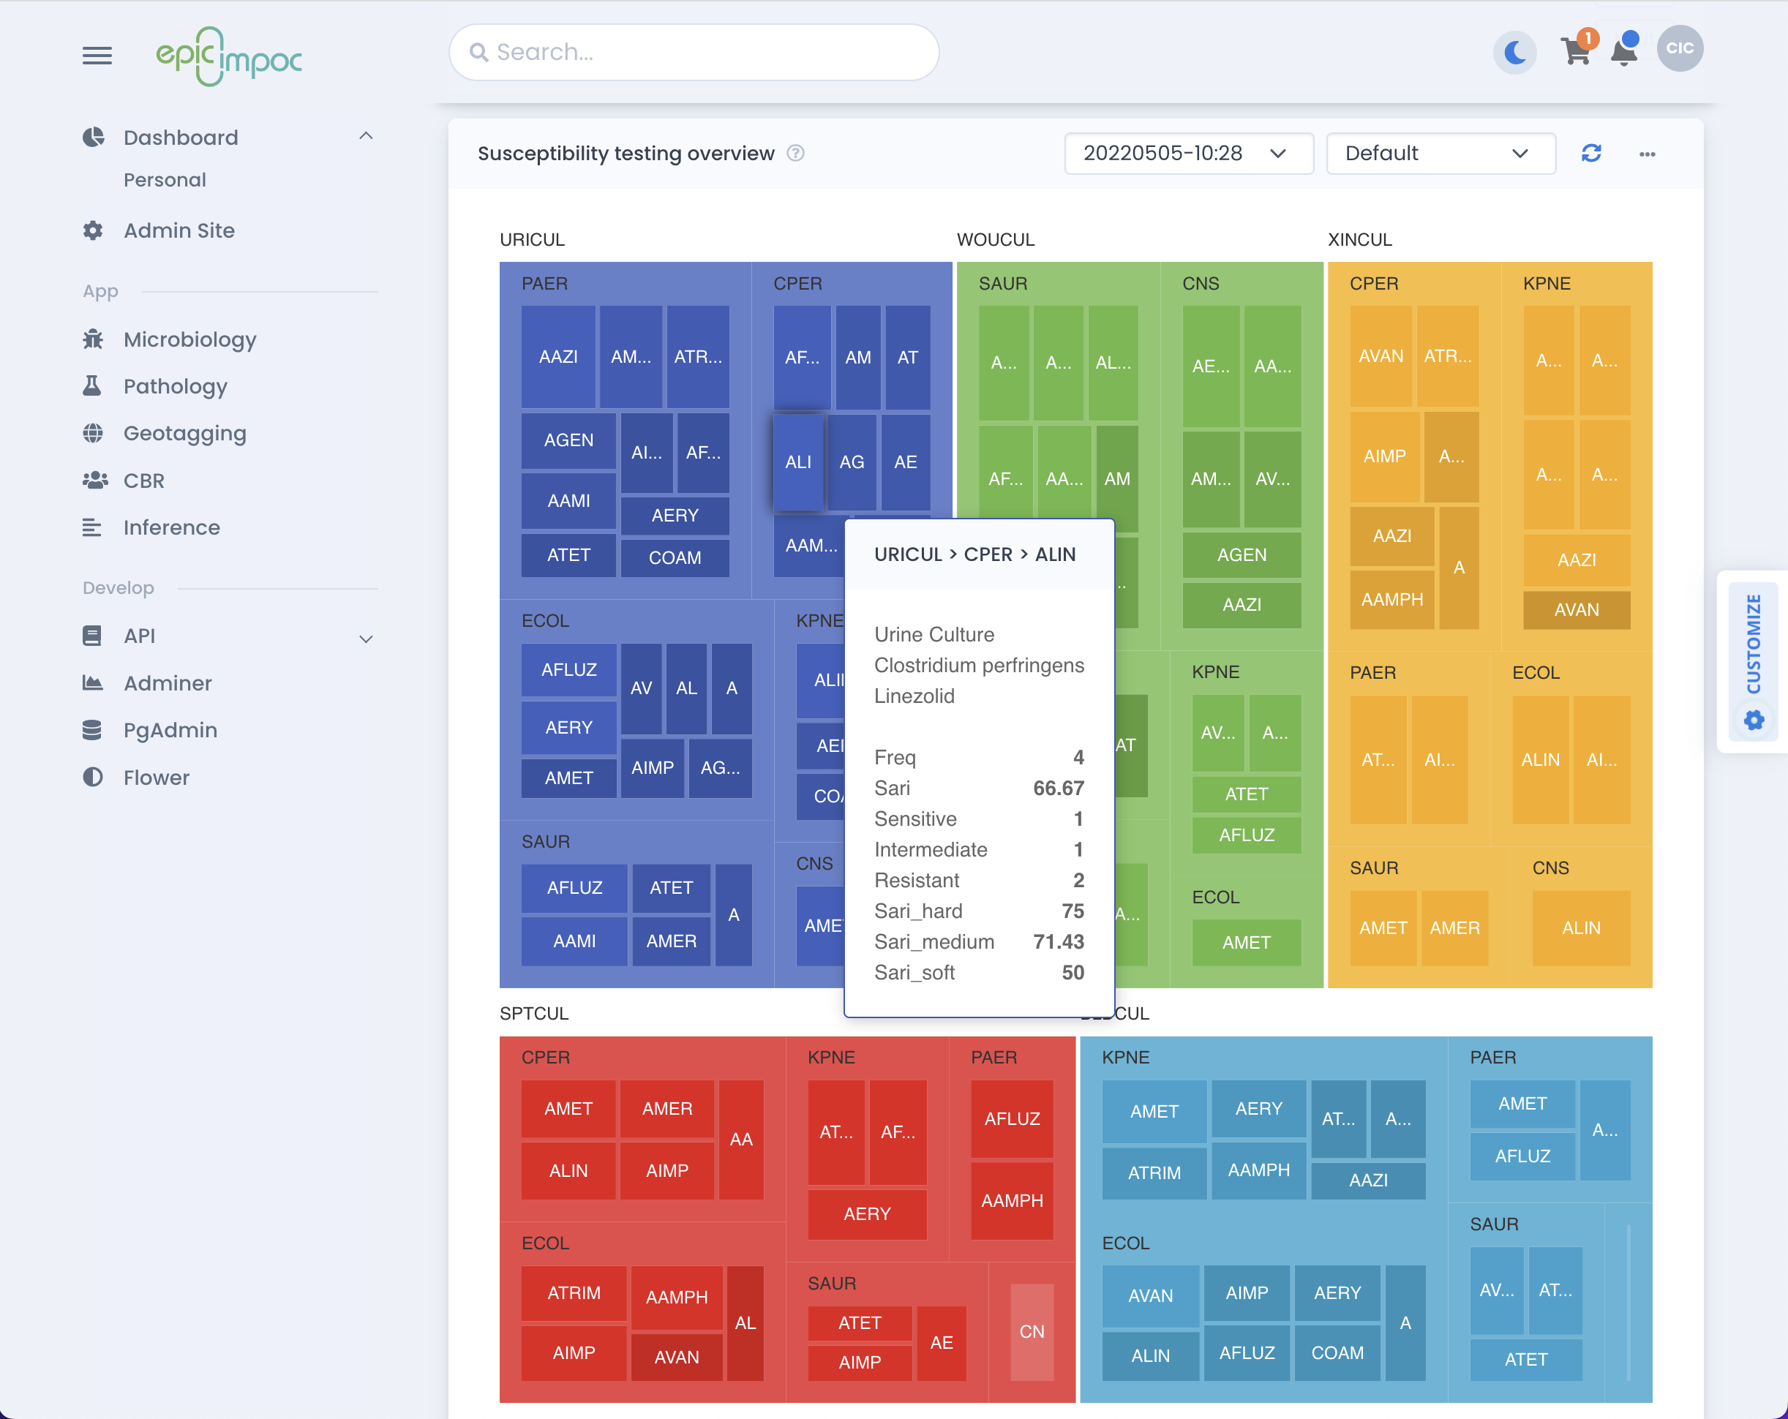



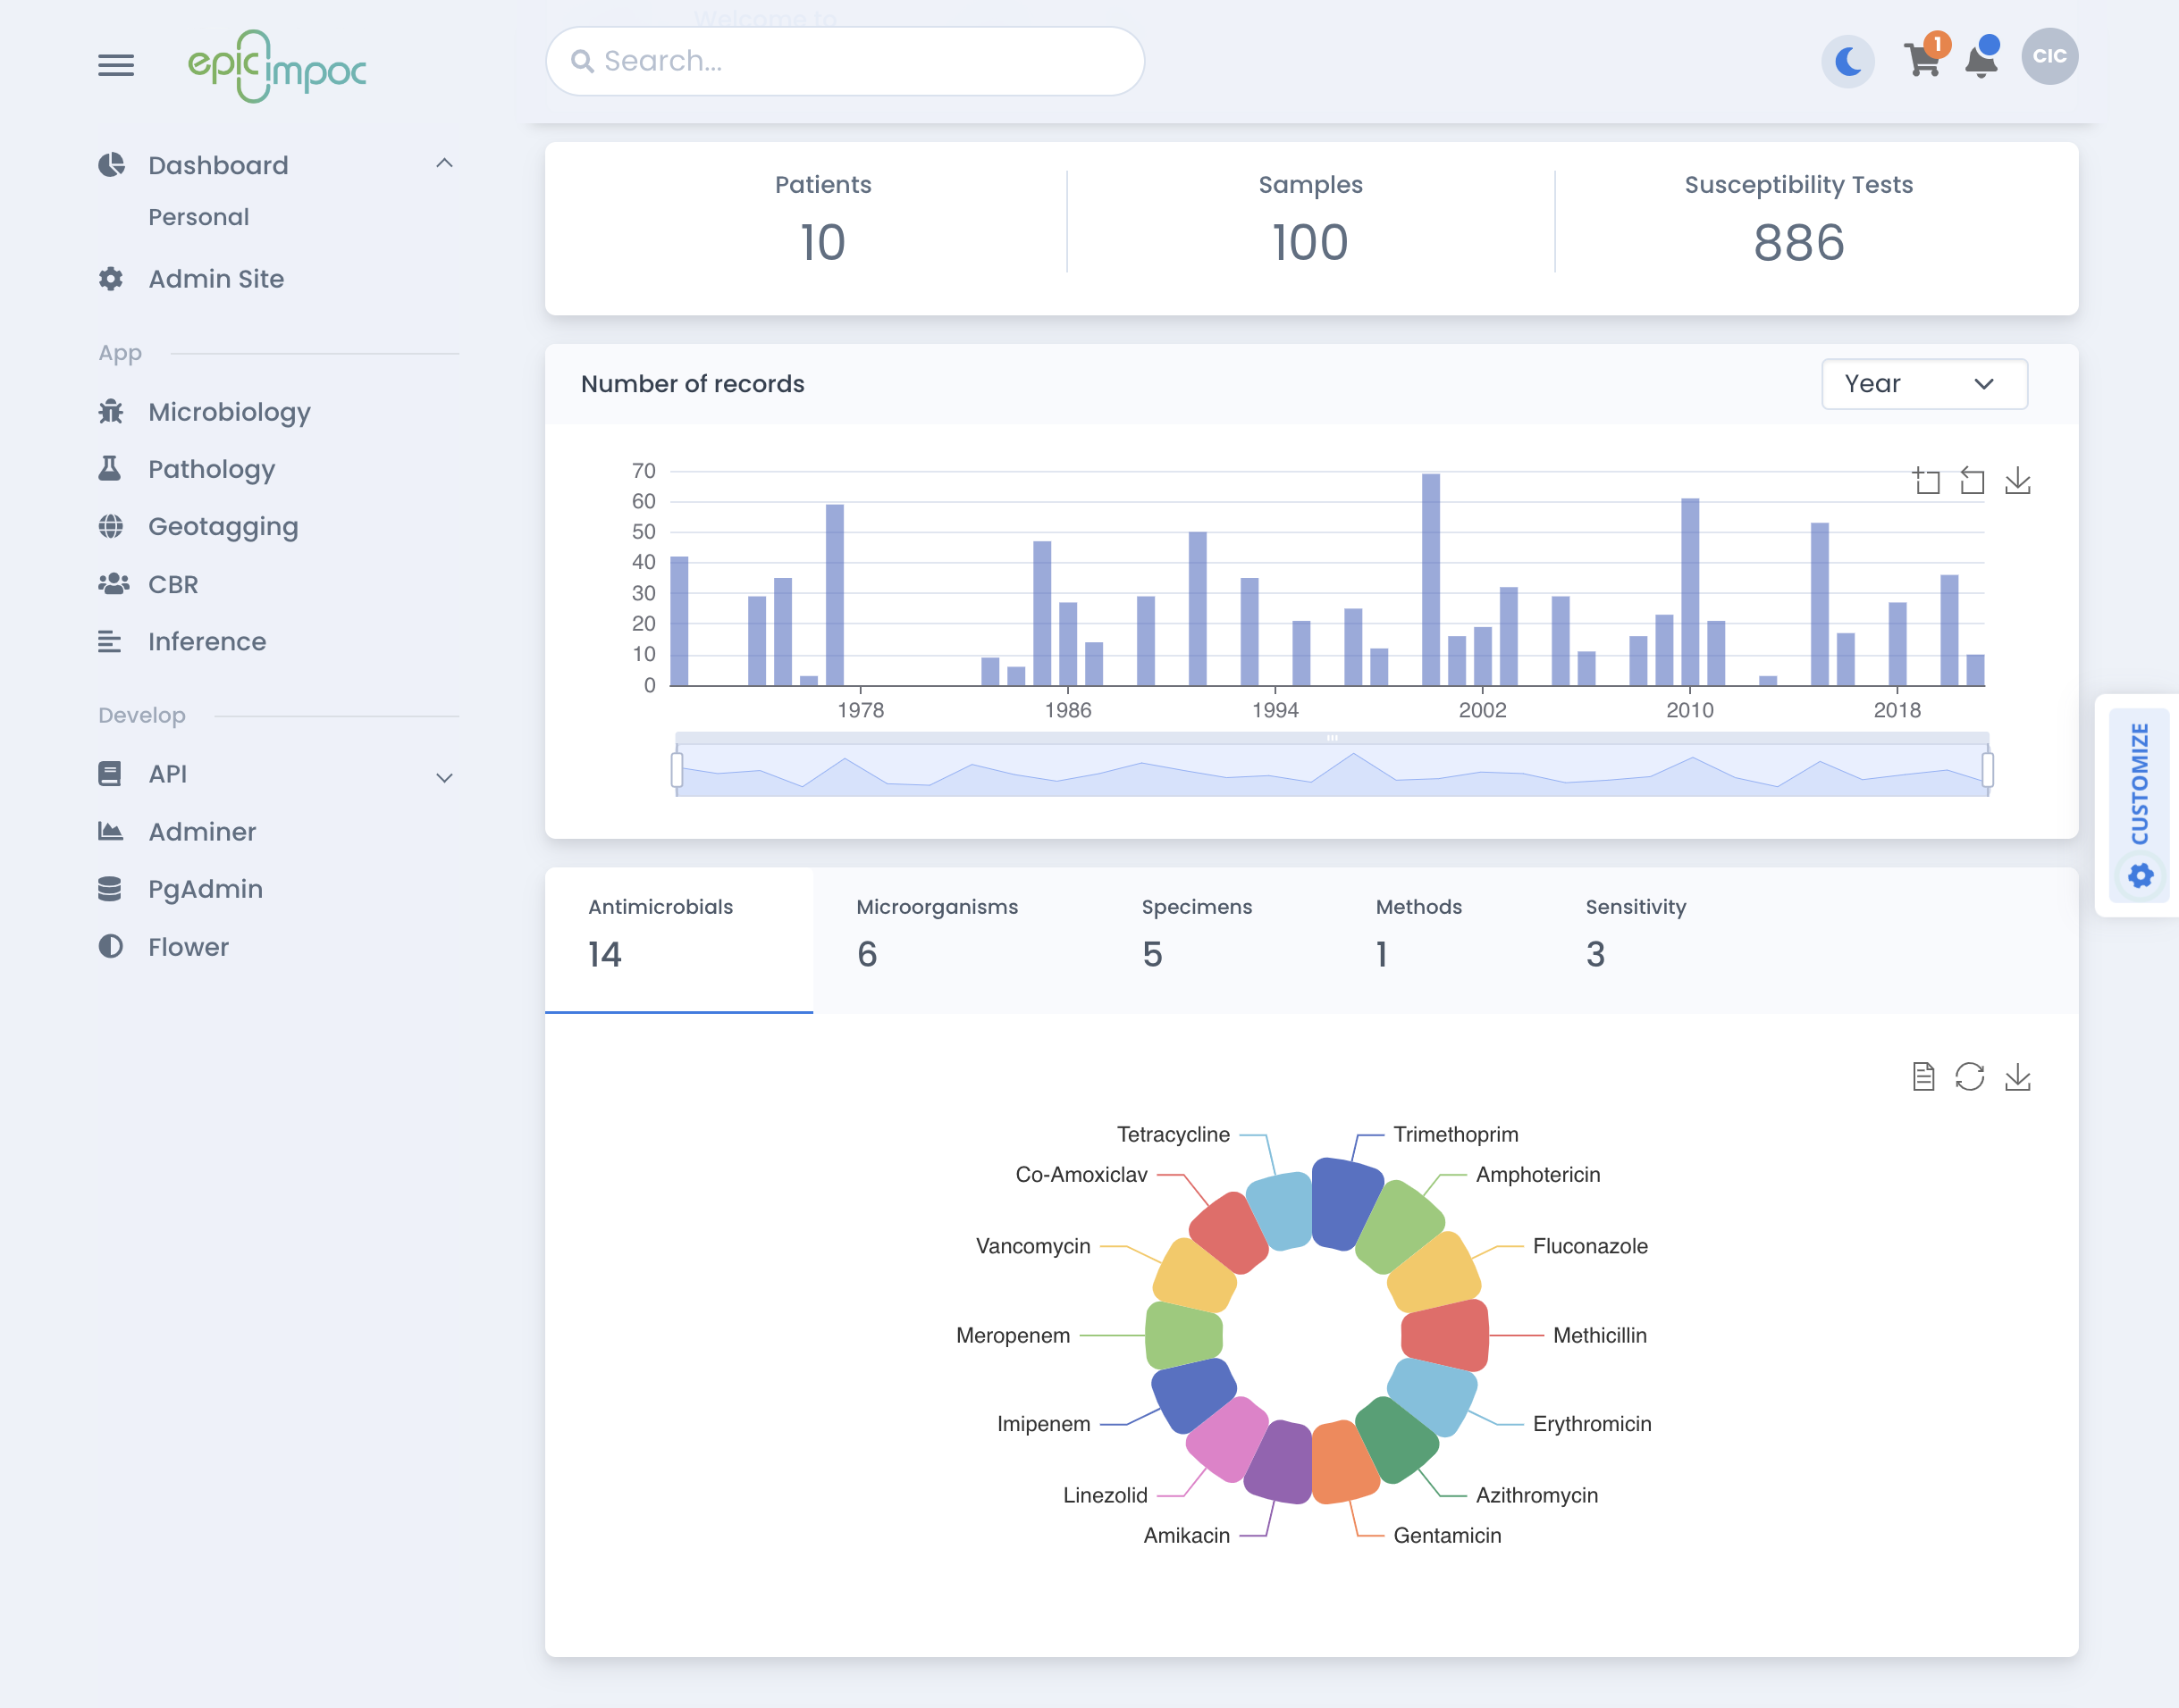
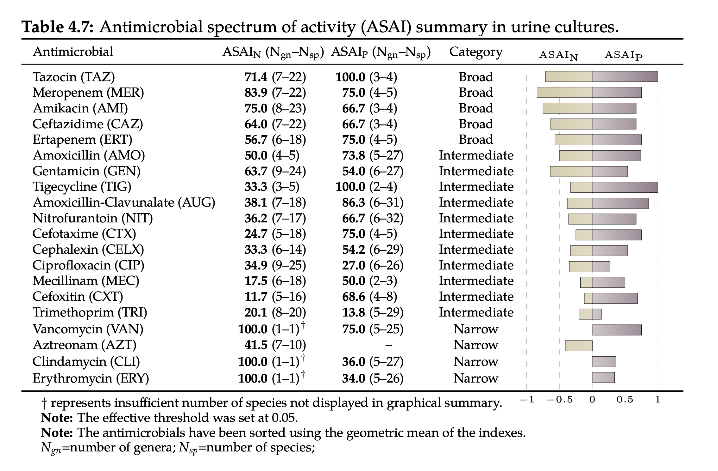
AMR SURVEILLANCE
Rates
Trends
The proportion of resistant isolates
Ratio of change of resistance rates over time
Multiple
Spectrum
Ratio of antimicrobials tested to which a pathogen is resistant
#microorganisms that can be treated with an antimicrobial
Concurrence
Whether resistance to one drug is associated to resistance to another
DRI
Ratio of resistant isolates to drugs used to treat them
B Hernandez – pyAMR Python library (2023) - https://bahp.github.io/pyAMR
B Hernandez –PhD Thesis Imperial College London (2019) – http://spiral.imperial.ac.uk/handle/10044/1/73000
B Hernandez et al - Resistance trend estimation using regression analysis to enhance antimicrobial surveillance: A multi-centre study in London 2009-2016 – Antibiotics (2021)
Notes:
Antimicrobial susceptibility testing or AST is a laboratory method used to determine the effectiveness of antimicrobial agents against specific microorganisms. It helps in guiding appropriate antimicrobial therapy by providing valuable information about the susceptibility or resistance of bacteria, fungi, or other pathogens to different drugs. Establishing quantifiable metrics using AST data is essential to gain a standardized and objective framework to monitor the emergence and spread of resistant strains, assess the effectiveness of antimicrobial interventions, and evaluate the impact of various interventions and policies. Such metrics enable us to quantify resistance levels, track trends over time, and compare data across different regions and healthcare settings, facilitating evidence-based decision making. Furthermore, these metrics provide a foundation for the development of sophisticated algorithms that can analyze vast amounts of data, identify patterns, predict resistance patterns, and assist clinicians in making informed treatment choices. By integrating these metrics into clinical decision support systems, healthcare providers can access real-time, data-driven insights to optimize antimicrobial therapy, improve patient outcomes, and mitigate the further development and dissemination of antimicrobial resistance.

Slide 8
QUESTIONS
?
Bernard Hernandez
b.hernandez-perez@imperial.ac.uk
Department of Medicine
Imperial College London
https://bahp.github.io/portfolio-academic/
18th of May 2023

